Slide 1
A Modest Inductive Charger
Team 10
Jeff Brown Kati Dahn
Tyler Gilbert Jann Messer

Slide 2
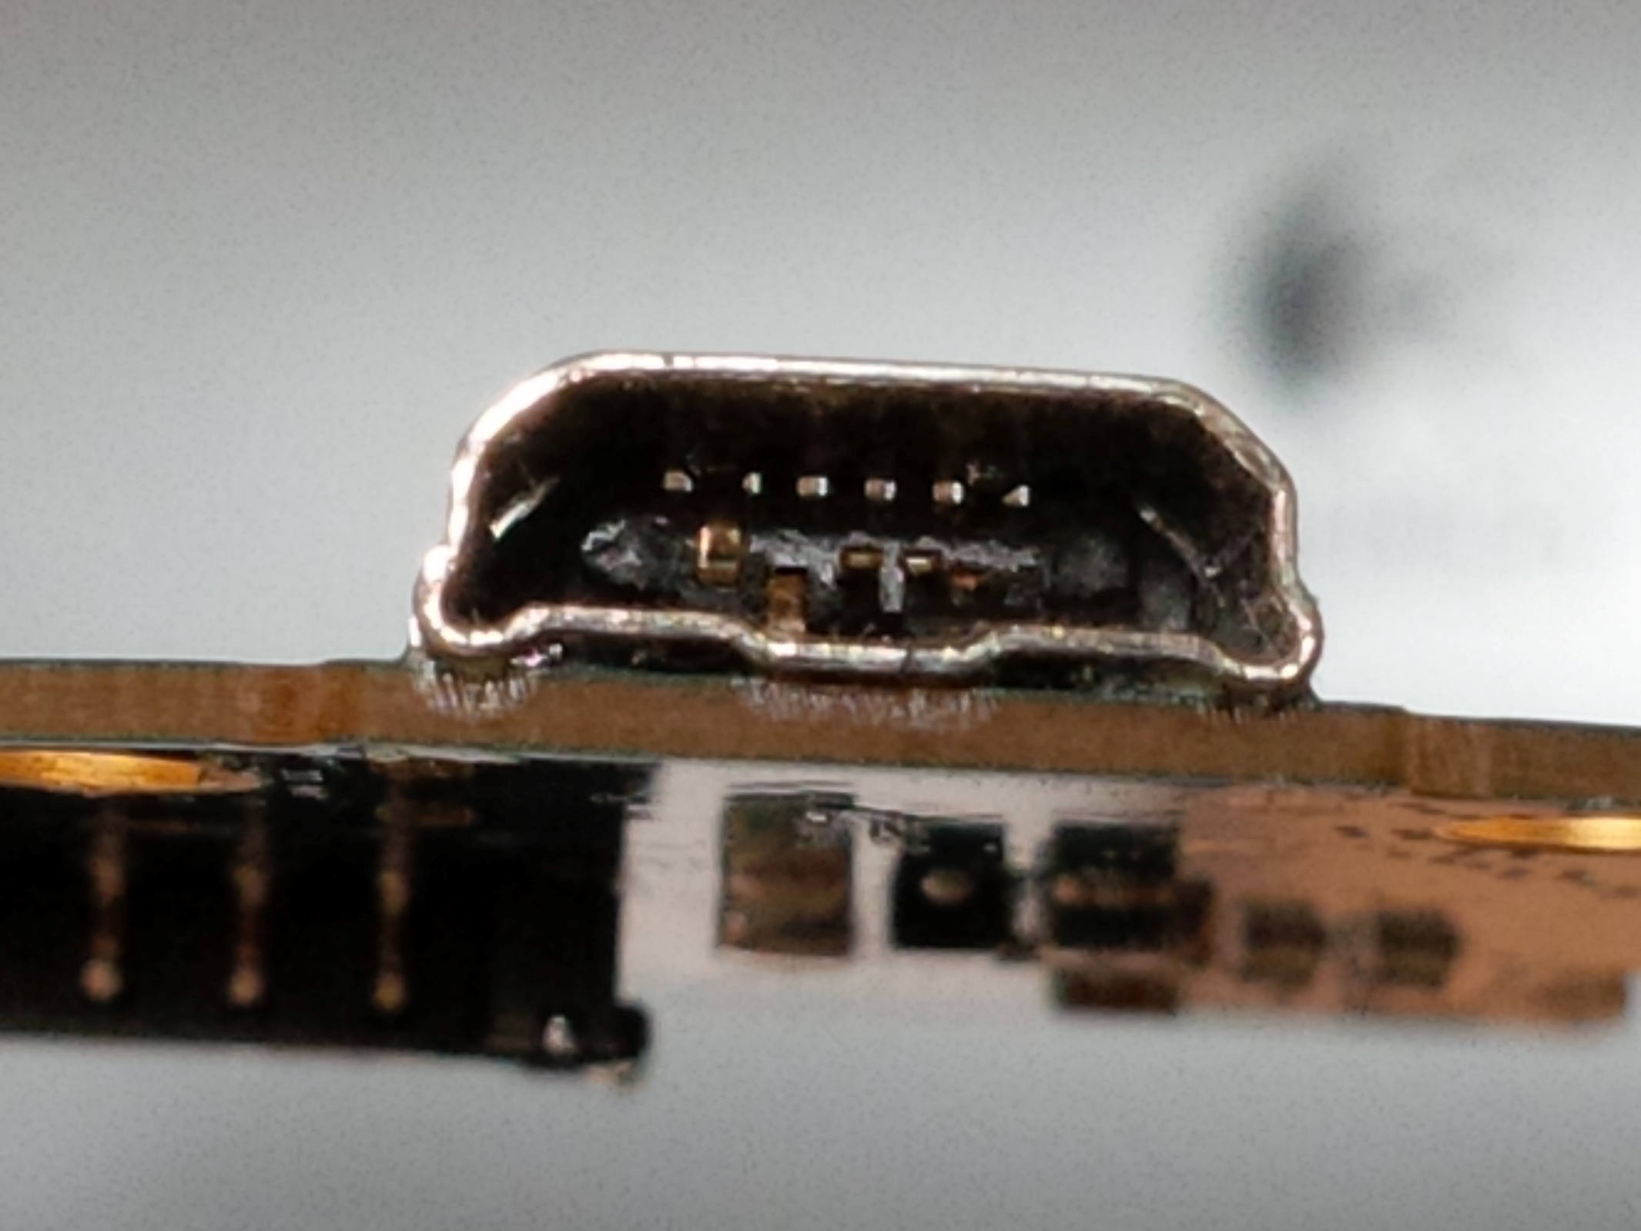
Notes:
“Has this happened to you?” – Motivation of Inductive Charging

Slide 3
Motivation:
“To become more familiar with wireless energy transmission and explore integrating wireless charging technology into consumer electronics.”
Notes:
Motivation: While this technology is already commercially available and several wireless charging standards exist (Qi, Rezence), the purpose of this project is to become more familiar with wireless energy transmission and explore the feasibility of integrating wireless charging technology into consumer electronics.

Slide 4
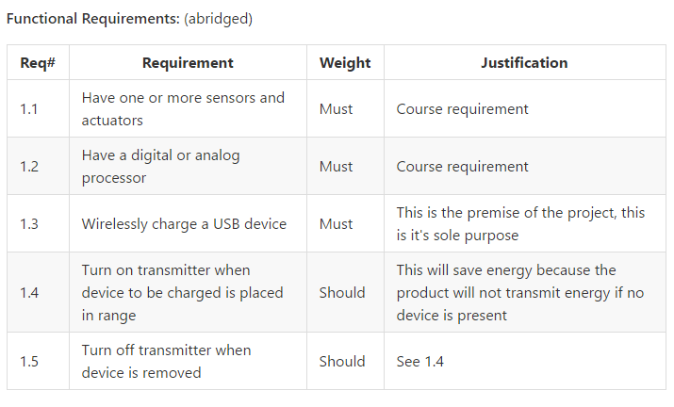
Notes:
Pause here a moment, than advance slide.

Slide 5
Notes:
The Objective – “Wirelessly charge a USB device” That’s It!
To explicitly address the second sentence – a working prototype is desired.

Slide 6
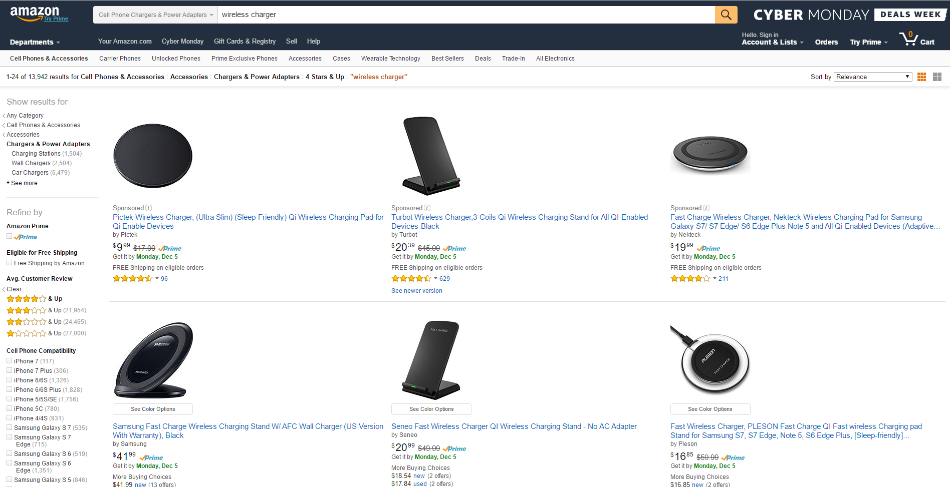
Notes:
Existing Solutions
Like our objective, many of these products target the USB devices market.

Slide 7
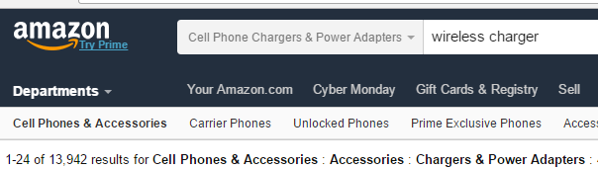
No wheel reinvention here.
Notes:
Continued from previous slide
As Amazon shows us, their exist a plethora of options available.

Slide 8
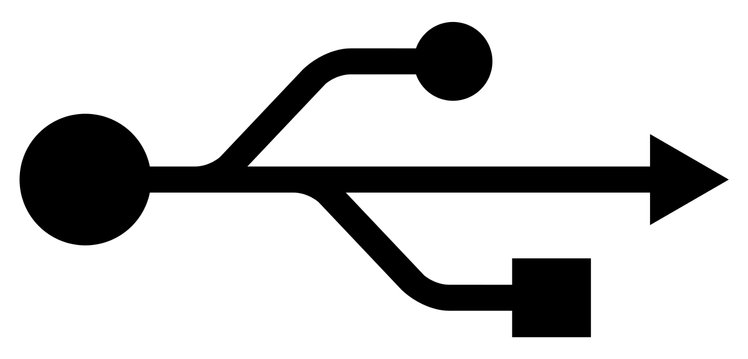
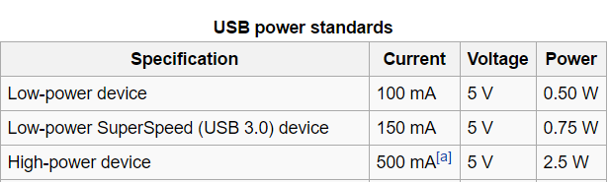
Notes:
Requirements –
An acceptable solution would be a device that supplies USB spec power.

Slide 9
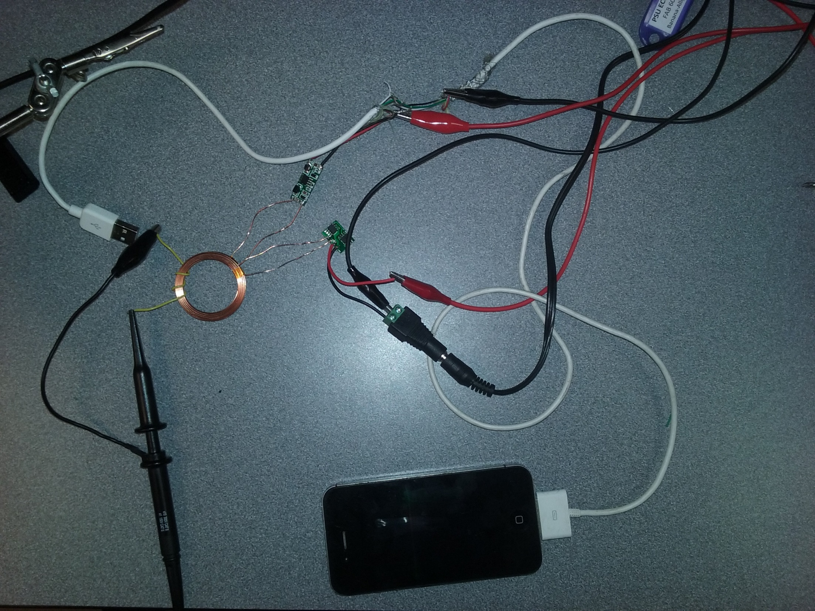
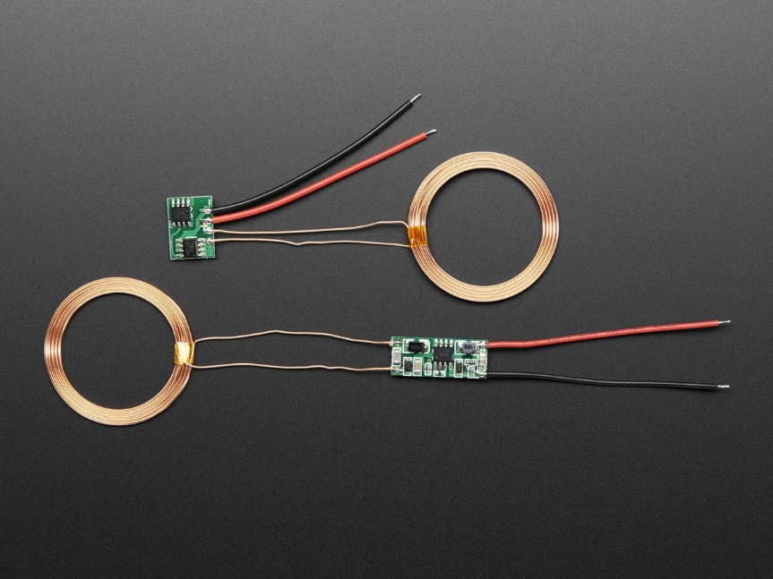
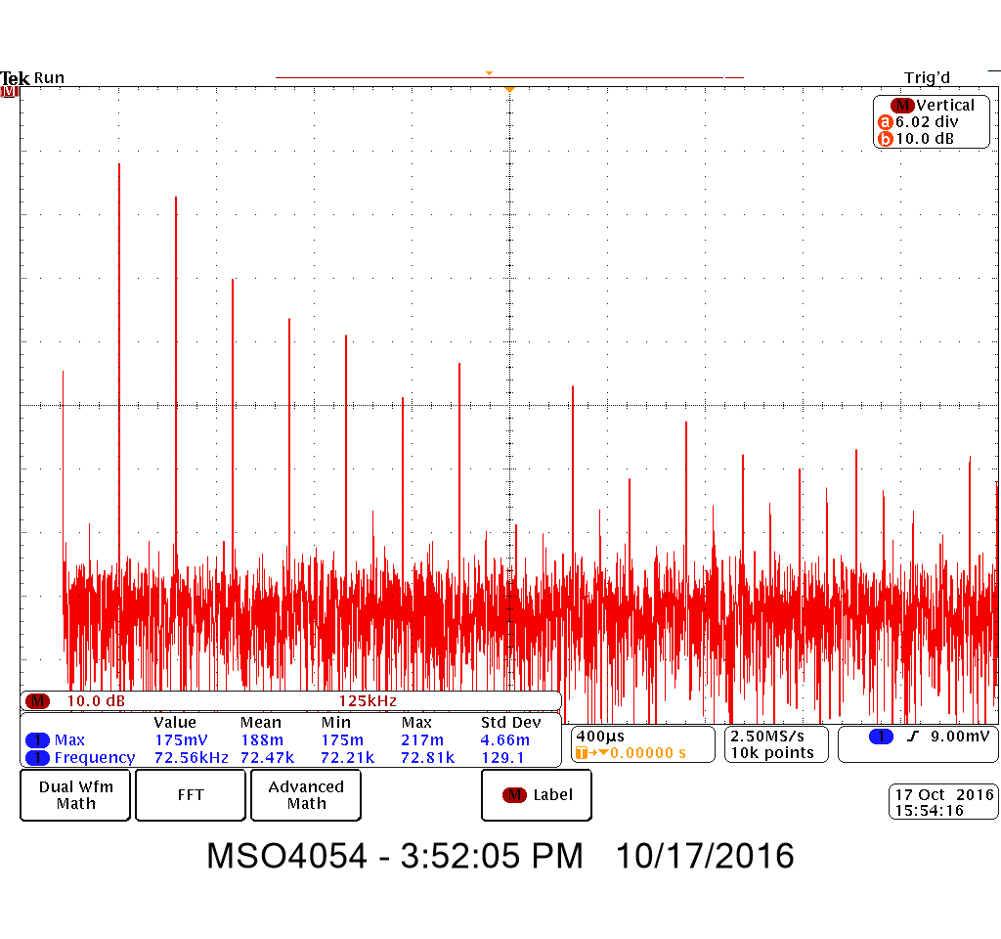
Notes:
Approach – Test and Characterize an existing product. Seen here is a set from the Adafruit company. We turned the set on and used a few turns of hookup wire as an inductive tap. With this we were able to characterize the output waveform. Seen in the lower right of this slide is an FFT of the transmitter. This waveform is rich in harmonics. This led us to believe that sinusoidal driving isn’t necessary - wave shaping isn’t critical. Incidentally the time domain waveform looked like a half rectified sine wave with jitter.

Slide 10
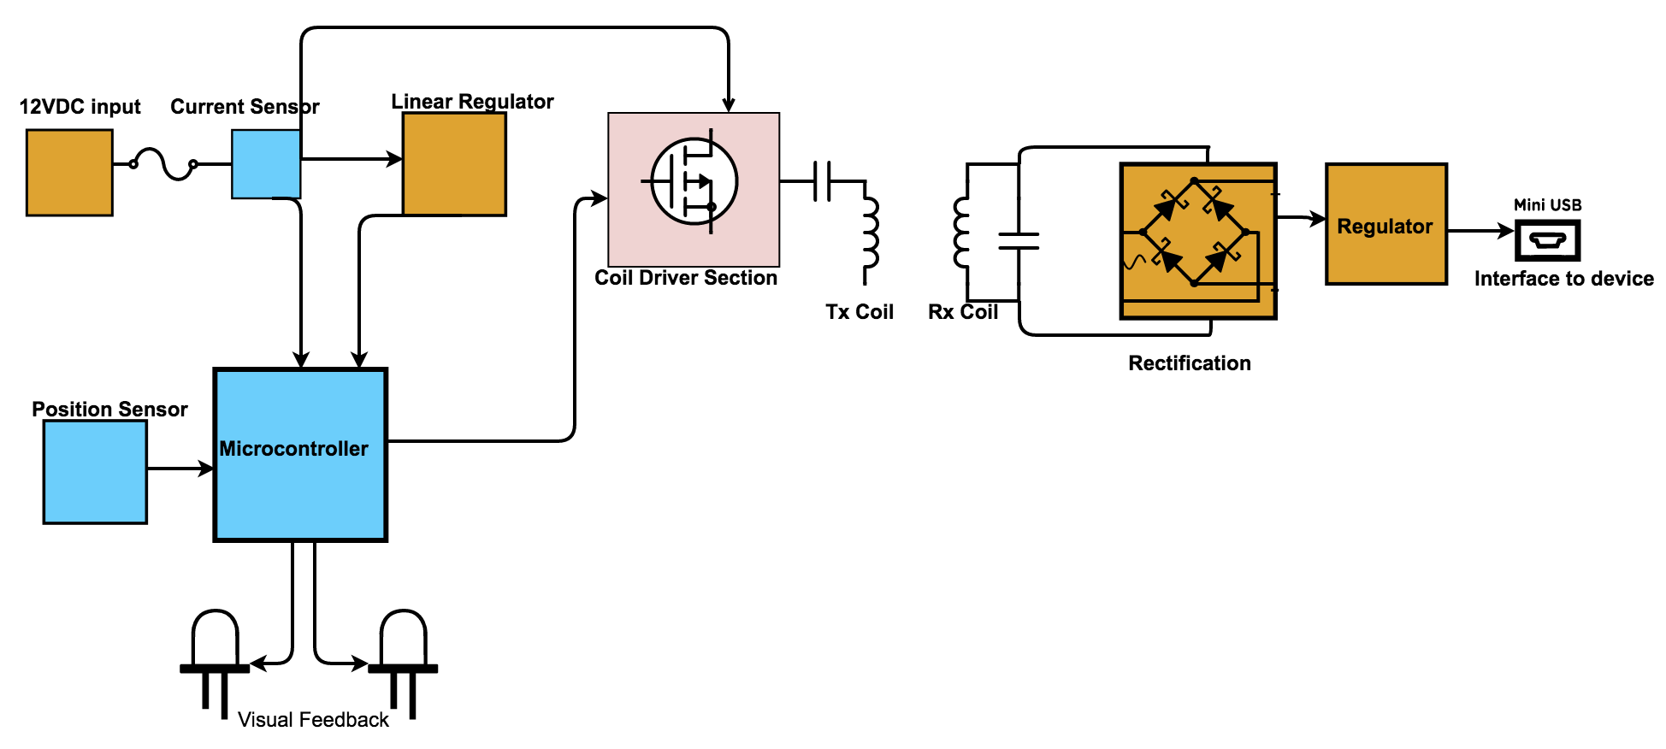
Notes:
Design Overview

Slide 11
Notes:
Design Overview

Slide 12
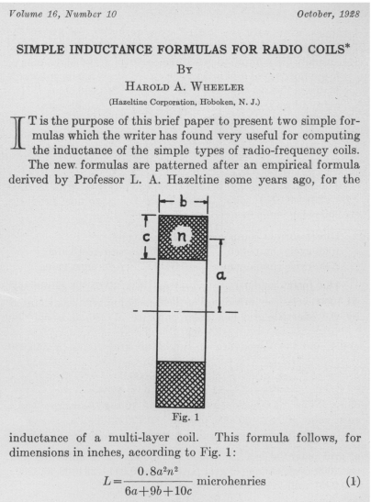
Harold A. Wheeler, "Simple Inductance Formulas for Radio Coils," Proceedings of the I.R.E., October 1928, pp. 1398-1400.

Slide 13
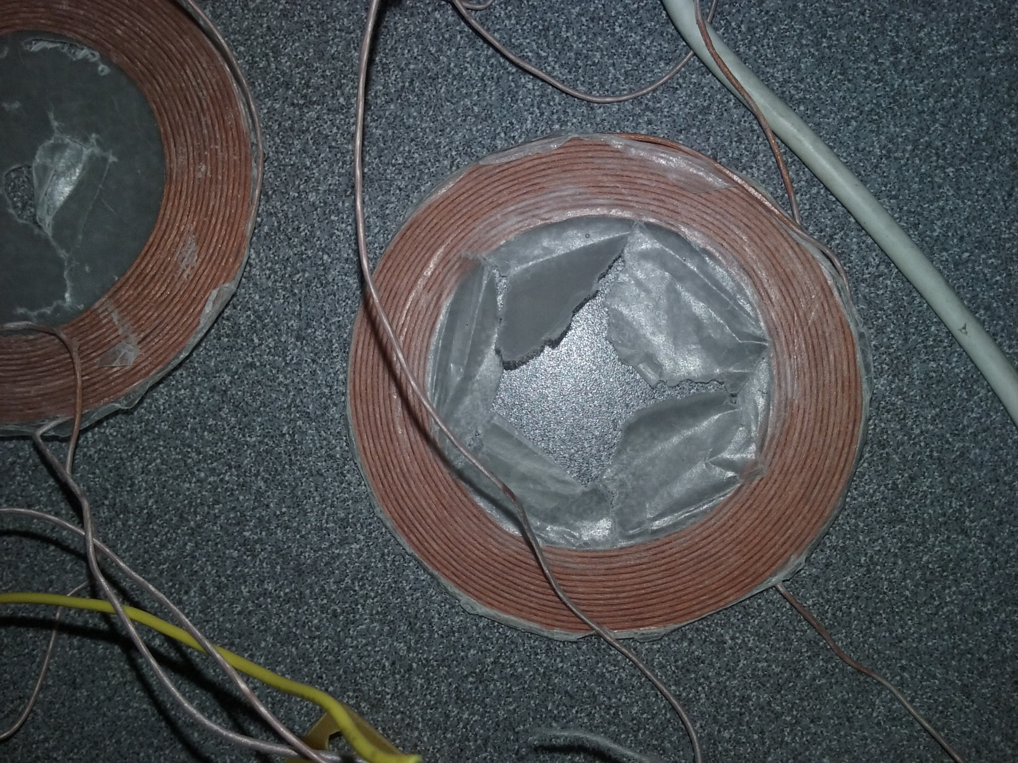

Slide 14
Notes:
Design Overview

Slide 15
Notes:
Design Overview

Slide 16
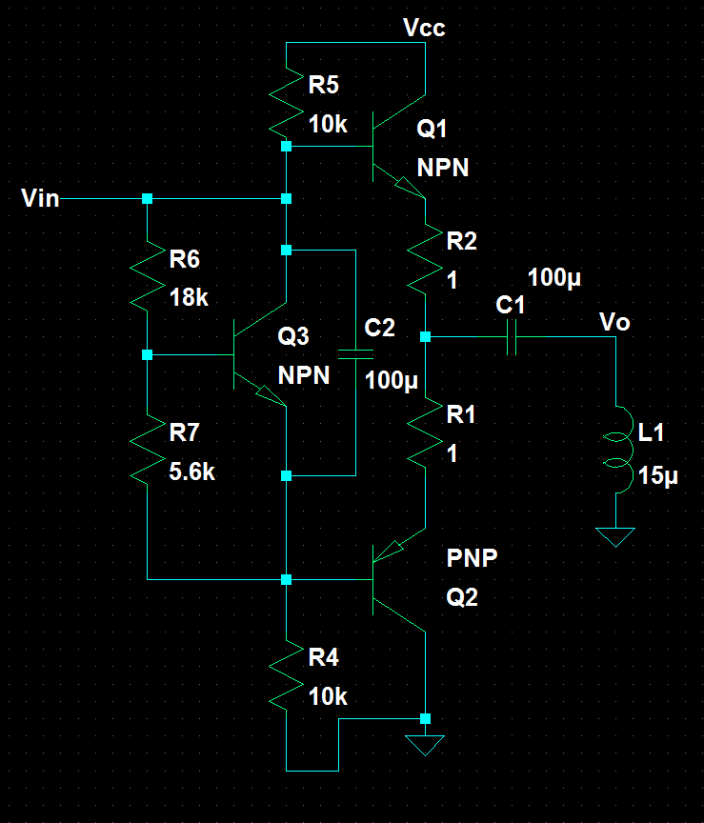
Notes:
Initial Output stage development
In another class we studied “Complementary Symmetry Amplifiers” an energy efficient and simple circuit.
In LT Spice this worked and met our design spec.

Slide 17
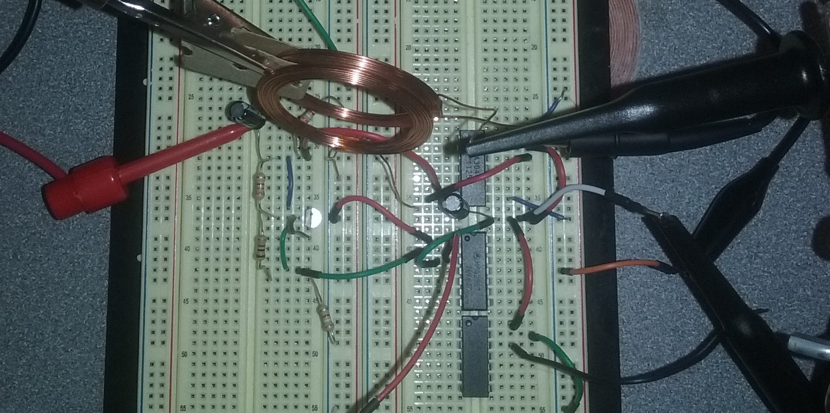

Notes:
Implementation
The circuit from before was built and tested with transistor arrays and single transistors. At first we used 2N3904s. Given a max collector current of 200 mA we reckoned 5 transistors or
So in parallel, depending on coupling efficiencies, would meet the USB power spec.
We constructed this circuit and it wasn’t quite what we expected. The warning decal in the corner gives some indication of what.
The why is, of course, nothing was heatsunk during testing.
This conclusion however was only reached after some non-trivial lab time. Many transistors had burned out but it wasn’t obvious with some of them. Additionally some transistors in our toolboxes were burnt out in ECE 322 but we had neglected our duty of throwing them out then.
Testing several with a curve tracer confirmed the suspicions. One lab session however our enthusiasm for carrying on was deterred by an acute lack of working transistors. Fortunately however we found a
stash of N-type Mosfets.

Slide 18
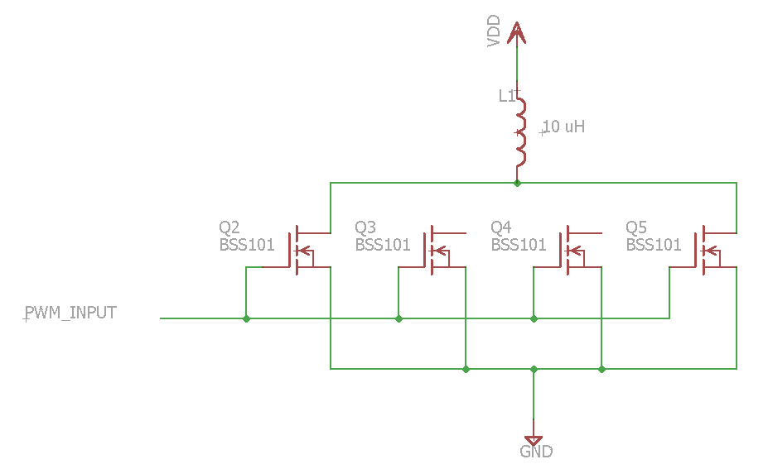
Notes:
After experiencing excessive heat dissipation in the transistors driving the coil and analyzing the FFT of the adafruit charging kit we realized that it was actually more efficient to drive the coils with a square wave rather than a sinusoidal wave. A direct PWM signal was sent into the driving transistor circuitry and proved our deductions correct.
The main reason for the greater efficiency in using a direct PWM input signal is because the mosfets only heat up when they switch and with a sine wave we are extending the period of time over which they switch. Whereas a square wave is much more near instantaneous and therefore the transistors don’t get nearly as hot.
This allows the coils to dissipate the heat rather than the transistors which is favorable due to their larger surface area as compared to the transistors.

Slide 19
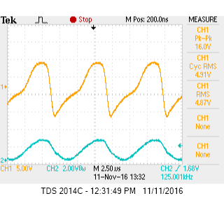
Oscilloscope capture of receiver coil with MOSFET output stage
Notes:
Success!

Slide 20
Notes:
Design Overview

Slide 21
Notes:
Design Overview

Slide 22
Microprocessor algorithm / state machine diagram

Slide 23
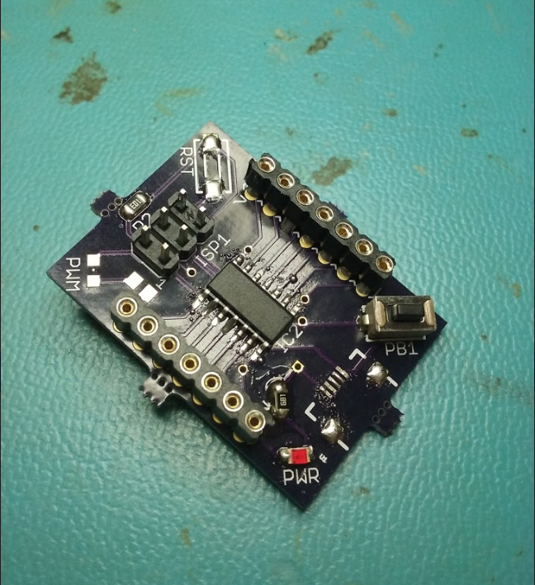

Slide 24
IP / prior work maybe ref. slide 8

Slide 25
